Slide 1
IECEE CB Scheme
CTF Program Overview*
CTF - Customers’ Testing Facilities
*SMT (Supervised Manufacturer’s Testing) program is being phased out.
July 6-10, 2015
Notes:
This slide deck is a high level OVERVIEW of CTF. Only cover this CTF deck AFTER completing ALL of the DAP LA training content. This CTF deck should only be discussed for about 30-45 minutes maximum. SMT needs to be referenced only in the PAST TENSE since the deadline for conversion to CTF was March 15, 2015.
Depending on the class audience* and the remaining available time, adjust the time as needed for presentation and questions/answers.
*If the majority of the class is in a region with many IEC client labs, then be sure to cover this Overview with sufficient detail.
Recommend students to access applicable IECEE CB Scheme procedures and forms, as well as UL documents and UL CB Scheme intranet site and the Internet for more and up-to-date details because this is only an Overview and there are continuous changes to both internal and external documents and processes.
Mention links to external websites (i.e. IECEE), etc. to give more on the program overview or leave slides that staff can look at if/when they want to. If students are interested in becoming a CTF Lead Auditor they can contact QE. Mention there are some LMS courses on the CB Scheme.

Slide 2
GAP between DAP CTDP and CTF Stage 3
UL CTDP is for USA and Canada Safety Schemes, CTF is for the rest of the world (based on IEC Standards).
CTF Stage 3 is similar to CTDP but CTF Stage 3 has more requirements (i.e. all ISO 17025 clauses apply)
CTF Stage 3 requires witness testing for selected programs between annual assessments.
All SMT labs transition to CTF (by March 15, 2015).
More about CTF:
IECEE CB Scheme provides standardized forms for all NCBs (National Certified Body) to conduct and record CTF assessments in a consistent way so reports/certificates from one NCB can be mutually accepted by another NCB. Refer to www.iecee.org
These standardized forms and standardized assessments are to ensure that data generated under CTF program are accepted.
The mutual acceptance of CB reports and certificates is accomplished through regular NCB and CBTL assessments, use of official TRFs, CTL Decisions and participation in PTP.
UL’s role:
UL has four NCBs: UL(US) , UL(JP) UL(Demko) and UL(CA).
UL typically conducts the CTDP and CTF annual assessments simultaneously and only uses the IECEE form reports to record the assessment instead of DAP CTDP report (DAP Tool, 00-OP-F0031).
As part of the UL review process, the UL NCB must sign the OD-2025 Assessment Report and issue the CTF certificate.
Some clients, based on their scope, may be working with more than one NCB. This requires more than one NCB review and certificate.
Notes:
IMPORTANT NOTE TO INSTRUCTOR, Bullet Point 4 (March 15, 2015 CTF transition date): Please verbally mention to the students that requests for transition have been filed but so far not all clients were converted by IECEE Secretariat. UL does not want people calling the NCB and asking what is going on since the due date has passed. UL (Jola Wroblewska) will keep following up on all transfers and monitor that all are correctly done.
REMIND THE CLASS THIS CTF SLIDE DECK IS HIGH LEVEL GENERAL INFORMATION ONLY, intended for those who know nothing or very little about CTF.
Many more CTF details will be provided if the auditor is enrolled in formal CTF training.
CTF audits usually require more work (time, documents/records writing, etc.) compared to an average CTDP audit (including pre-audit preparation, audit on-site visit and post-audit activities).

Slide 3
CTF Procedures & Definitions
OD-2048 – Third Party Utilization of Customers’ Testing Facilities (CTF)
Obtain most recent procedures and guidance from the IECEE website
CTF Program Definition:
Personnel of NCB or CBTL staff (if requested by NCB – i.e. UL Melville is a CBTL):
Supervises quality management system (QMS) of test lab (and in-house calibration, if applicable)
Witnesses part of agreed testing program
Manufacturer’s laboratory:
Uses its own personnel, test equipment, etc.
Signs and takes responsibility for CB Test Report (reviewed by NCB)
Notes:
IMPORTANT NOTE TO INSTRUCTOR, Bullet Point 4 (Signs and takes responsibility): Please verbally mention to the students that at UL we allow customers to submit test data only and then UL technical staff prepares the CB test reports. The NCB only reviews program compliance. Technical review is delegated to Engineering.

Slide 4
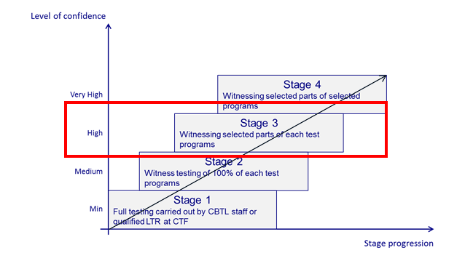
CTF Stages 1 – 4 (from OD-2048)
In-house calibration if not accredited would require metrology expert on assessment team.
For CTF Stage 4 => Witnesses part of agreed testing program
For CTF Stage 3 => Witnesses agreed tests from the testing program
For CTF Stage 2 => Witnesses 100% of tests
Notes:
This slide is from the IECEE CTF procedure OD-2048. CTF Stage 2 is similar to UL DAP Witness Test Data Program (WTDP), and CTF Stage 3 is similar to UL DAP Client Test Data Program (CTDP) – but emphasize CTF does have more requirements than DAP.
CTF Stage 4 requires a IECEE Peer Assessment to be arranged by the responsible NCB.

Slide 5
CTF Program Overview
CTF - manufacturer’s laboratory utilized to test products for which it has production responsibility, under supervision of NCB. The manufacturer’s laboratory can also be a contract manufacturer’s laboratory.
NCB or CBTL wishing to use this program must have relevant product categories and standards on their accepted IECEE scope.
UL staff who conduct assessments, must have competence in relevant IEC standards on UL CTF Stage 3/4 / CBTL Lead and Technical Assessor Matrix. CBTL technical assessors are not required to witness projects. Their role is to assess competency.
For DAP participants in the combined DAP+CB Scheme programs, same Lead Auditor if qualified for both DAP and CB Scheme can carry out during same on-site visit reassessment Audits for both DAP & CB Scheme programs.
Relevant NCB must approve use of CTF program.
Notes:
Supplemental information for Bullet Point 2 (CBTL technical assessors are not required to witness projects. Their role is to assess competency.): The assessment of competency is done by witnessing test demonstration but this demonstration is not necessarily project related. Also looking at the test setup, test equipment, asking test method question is acceptable way of assessing CBTL competency.

Slide 6

Questions?
Notes:
Remember this is just a high level Overview of CTF, and due to UL organizational changes and other external changes, CTF processess & procedures are always subject to change.
The UL staff interested in obtaining CTF qualification need to contact their manager and the QE department for more information.

